Slide 1

TAILORING
Michael (Mikey) Plavins
Notes:
Notes:
One of the strengths of SmartMove is the ability to adjust the SmartMove settings.
You get complete control over how the system operates.

Slide 2
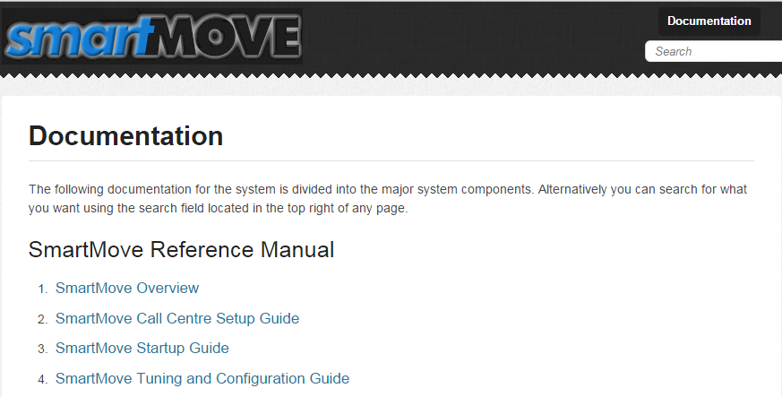
REFERENCE
Notes:
Notes:
The help section of the website contains the chapters of the reference manual.
Topics covered today are largely covered in the Tuning and Configuration Guide in chapter 4.

Slide 3
FLEET CONFIGURATION
Notes:
Notes:
This talk will largely centre on the fleet configuration section of the website.
This has various “tabs” that directly affect the way SmartMove operates.
We will work through some of these options slowly.
Using Bunbury as our example. Thank you Sue.

Slide 4
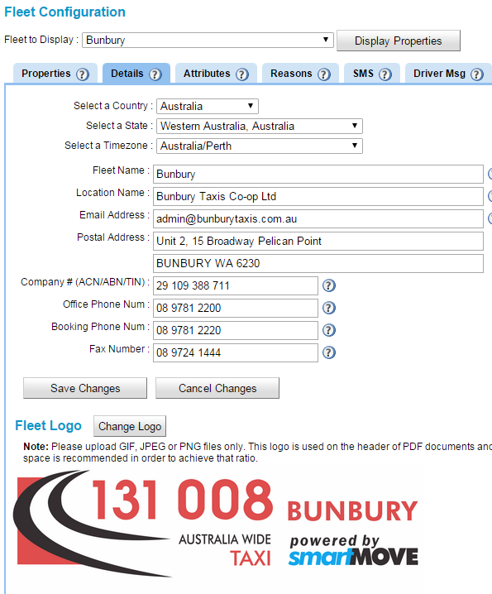

FLEET CONFIGURATION
Details
Notes:
Notes:
The details tab provides various administrative details.
Used in various places, including the invoice header shown here.
Note that the logo works best when a ratio of 5:2 is used. i.e. 2.5 times wider than high.

Slide 5
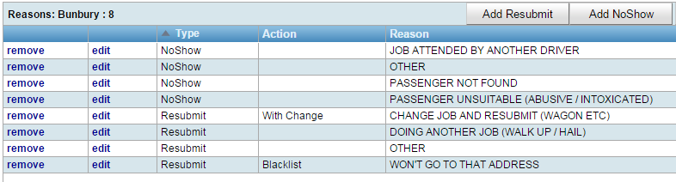
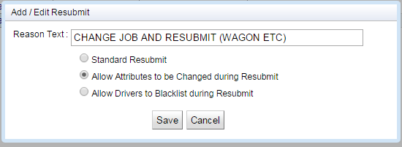

FLEET CONFIGURATION
No show, resubmit reasons
Notes:
Notes:
Can have up to four reasons for no-show. Whatever words you like.
Reasons are recorded in the booking details.
For resubmit you can allow the driver to change the booking or to blacklist an address.
-- the server does some checking if the “change” is valid – typically that the vehicle is near the pickup point and the change actually makes this vehicle ineligible; if the vehicle really couldn’t do the job then the driver will get their queue position back automatically.
Some fleets don’t allow drivers to create blacklist entries. They can only be done at the base.

Slide 6
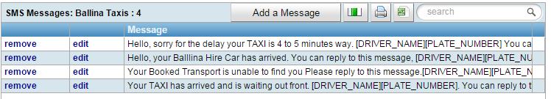

FLEET CONFIGURATION
Messages
Notes:
Notes
Drivers can send a message to the passenger. Smartphone App and mobile phone bookings only.
App messages are always free and are sent directly to SmartHAIL. There is a Fee for SMS if using our supplied SIMs or by using one of our gateways.
Will be using a new gateway which will significantly reduce the price to hopefully less than 15c per message.
One option will allow for drivers to get replies from passengers (already possible, if sent through the vehicle sim which is currently expensive).
Driver can also send message to base operators. Pick from list OR type a message if allowed.
No charge for messages to base.

Slide 7
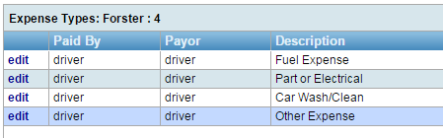
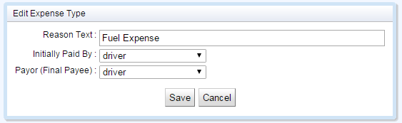
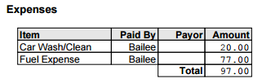
FLEET CONFIGURATION
Expenses
Notes:
Notes:
The expenses are included in the end-of-shift report.
Need to distinguish between who initially paid the bill and who is ultimately responsible for paying a bill. E.g. driver might buy a new bulb but car expenses are normally paid by the owner.

Slide 8
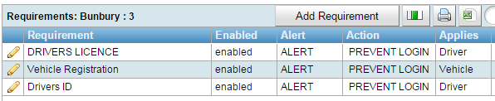
FLEET CONFIGURATION
Requirements
Notes:
Notes:
These have been discussed separately.
Tedious to set up but once in place they guarantee that obligations are met. Well worth the effort.

Slide 9
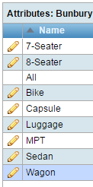
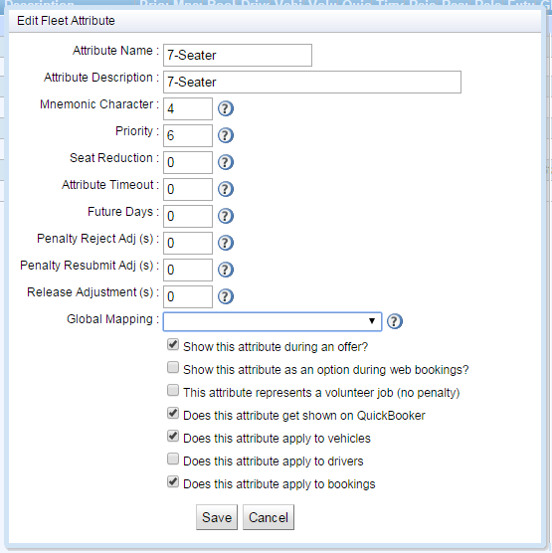
FLEET CONFIGURATION
Attributes 1
Attributes are critical!
Notes:
Notes:
There are a wide variety of attributes used in fleets.
There may not seem like a need for distinct 7-seater and 8-seater attributes – since the number of passengers will handle that difference during actual dispatch;
However attributes can be a really useful way of managing your bookings - they have a number of other settings and uses that are discussed on the following slides.

Slide 10
FLEET CONFIGURATION
Attributes 2
Priority
Jobs of lower priority are hidden from drivers until the high-priority work is cleared
No location dispatch if >=6. Used for wheelchair vehicles.
Notes:
Notes:
Priority is perhaps the most important and is often used to manage high-demand vehicles properly
In some fleets Wheelchair work must be attended to before other work by those vehicles
Fleets will usually want their MAXI/VANS to take those specialist jobs before taking other work
General Rules:
Anything with a higher-priority attribute than other bookings will go out first – the vehicles will not even see anything of a lower priority until that work is cleared. You can use this for example to set 8-Seater slightly higher priority than 7-Seater, so that if the there are both jobs available the 8-Seater job will go to the only vehicle that can do it instead of it taking the 7-Seater job by chance.
There is a special value of >=6, which means that any bookings with those attributes will be automatically set to no-location-dispatch, meaning it will be given to the closest car without worrying about zones.
If you ever forget the magic number 6 you can hover over the question mark to see the description. 6 normally used to ensure wheelchair work goes to any available wheelchair vehicle. Sometimes used for Maxi work as well.

Slide 11
FLEET CONFIGURATION
Attributes 2
Attribute timeout
Remove attribute if no car available, eg Silver service car
Future days
Days in advance driver can see future work
Penalty reject
Adjustment to penalty for rejecting the offer
Penalty resubmit
Adjustment to penalty for resubmitting
Adjustment to release time
Wheelchair loading
Capsule/Van
Global mapping
What is matching SmartHail vehicle type?
Notes:
Notes:
Seat reduction can apply when seats have to be folded up to take a wheelchair – if you think this would be useful please let us know
Attribute timeout: can be used to relax the restrictions on a job e.g. Island Taxis in NZ. Allow second fleet to take the booking.
Future days linked to the ability to see upcoming jobs. Normally used for WAT vehicles.
Penalty reject/resubmit: some fleets want greater penalty for reject/resubmitting particular kinds of work.
Adjustment to release time. For some work may need to allow extra time to ensure booking is on time.
E.g. extra time to load a wheelchair, or time to collect baby capsule from base, or even extra time for high-demand vehicles to be
able to better manage their bookings – your Maxi or Van drivers might like to know that there is a Maxi job coming up so that they don’t
Take other jobs first

Slide 12
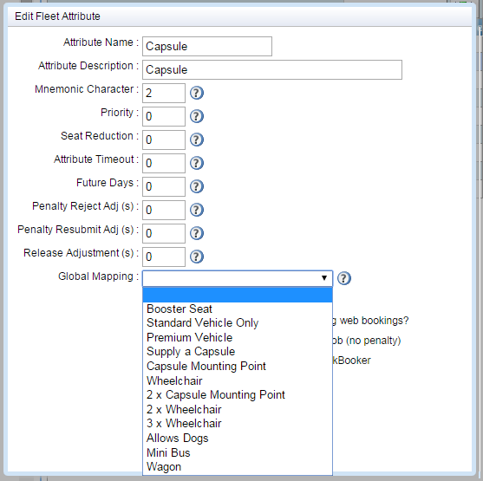
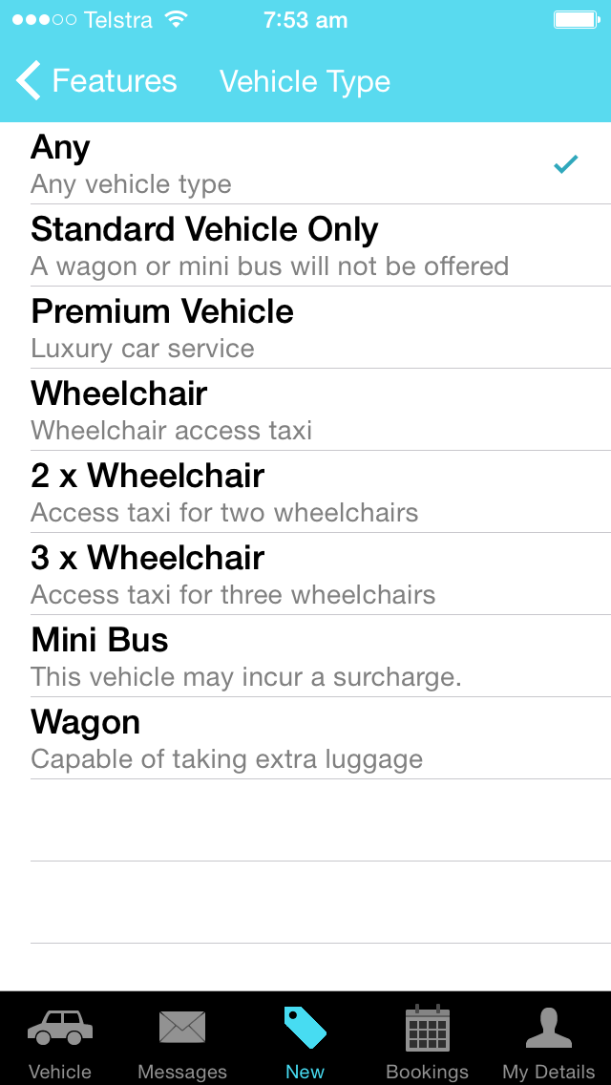
FLEET CONFIGURATION
Attributes 3
Notes:
Notes:
Global mapping used with apps.
SmartHail offers generic vehicle types
You have to tell us what attributes to set when a SmartHail booking is received.
e.g For Bunbury:
- Wheelchair should be applied to MPT attribute if they want to accept wheelchair bookings with SmartHail. Not currently set.
- No attribute covers 2 x wheelchair or 3 x wheelchair. Jobs have to be dispatched to a particular car.

Slide 13
FLEET CONFIGURATION
Attributes 4
Show during offer
Appears on driver screen when offer made
Web
Allow limited types via the web
Volunteer Job
No penalty applies
Quick Booker
Allow limited types
Vehicles
Eg Wheelchair vehicle
Drivers
Eg Authorised for school runs
Bookings
Can be used to turn off an attribute
Notes:
Notes
Offer: This is rarely used – but can be used if you have a type of job that drivers might typically avoid. Once they accept the offer and get the full job details they can still resubmit, but usually at a higher penalty.
Web: e.g. May not allow wheelchair or maxi booking on-line so that you can manage customer expectations if you are busy.
Volunteer: e.g. Carrying (non-service) dog, or a customer requesting an IOU job
Quickbooker: as with web/app bookings you might only like ‘standard’ bookings to be taken automatically, and have other customers ring for a booking
Vehicles: Used to select the right type of vehicle type. E.g. Maxi.
Drivers: Used to select the right type of driver e.g. Wharf pass, female-driver-only
Bookings: This is how you would turn off an attribute when it is no longer required. Any attribute with this set will show up on the Dispatch Client as a possible option to add to a booking.

Slide 14
DISPATCHING
Three options
Standard — Zones + Cover
Bidding
Closest car
Notes:
Notes:
Will discuss each of these separately.

Slide 15
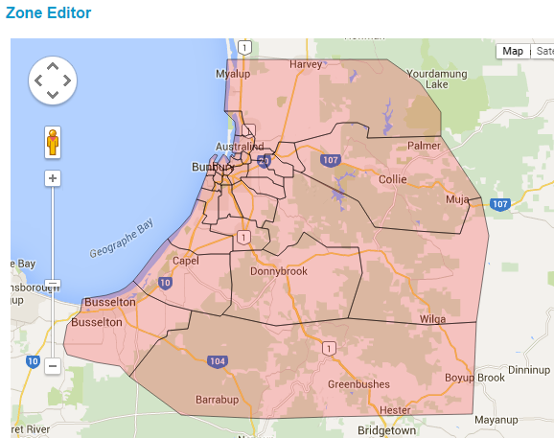
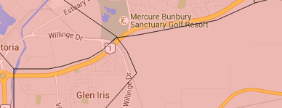
DISPATCHING
Standard Zones + Cover
Notes:
Notes:
You can change your zone boundaries whenever you like.
Don’t want boundaries running down streets as GPS in vehicle will drift from one zone to the other and constantly reset their queue position. Example here is correct.
Normally have zones well outside operating area so that a zone name can be shown for cars well out of town.

Slide 16
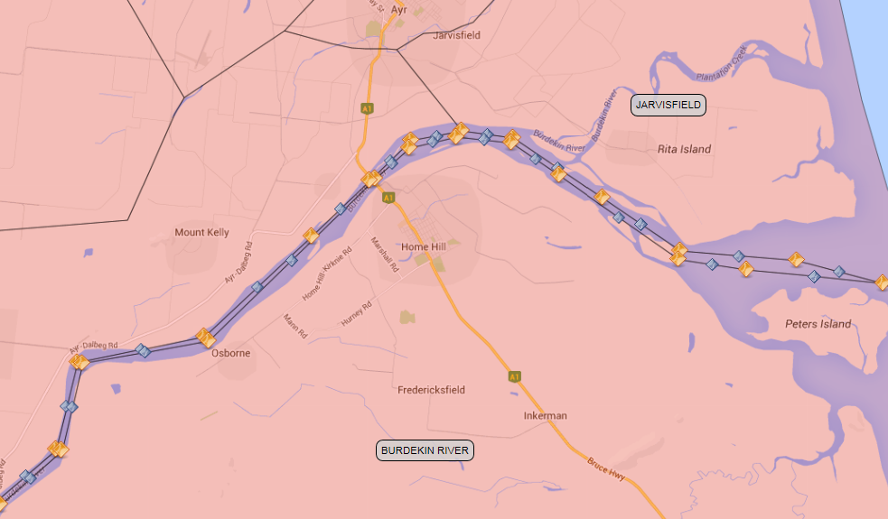
DISPATCHING
Obstacle/Waypoints
Notes:
Notes:
You can also create zones that indicate obstacles within your dispatch area.
These are used for things like rivers or train tracks, where it is difficult to get from one side to the other
Once you have created the zone that covers the obstacle you need to add a property – this gives the obstacle a description, identifies the zone number and gives any possible ‘waypoints’.
A waypoint is a route to get from one side to the other – such as bridges or railway crossings – and may include the ends of the obstacle (such west of this river but not east as it ends in the ocean).
Put simply the algorithms for limiting cover distance and for assigning to the ‘closest’ car will calculate better how far the vehicle actually has to travel to get to a job on the other side of the obstacle.
This property is usually a super-user property because of the particular format required, contact support to get help setting it up.

Slide 17
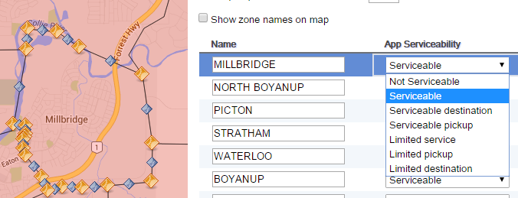
DISPATCHING
Standard Zones + Cover
Dispatching for apps
Not Serviceable
No app bookings accepted for this zone
Serviceable
All app bookings accepted
Serviceable Destination
Will accept booking if destination is in this zone
Serviceable Pickup
Will accept booking if pickup is in this zone
Limited Service
Other address must be serviceable
eg out of town
Limited Pickup
Can only be used for pickup
Limited Destination
Can only be used as destination,
eg no pickup at airport
Notes:
Notes:
These options are used to regulate the SmartHail app bookings (and other apps)
Not Servicable: You can use this whenever you would like to stop receiving automatic bookings for a certain area.
You might do this during a large event where there is no way you can cover all of the bookings so making it not serviceable forces the customer to contact the call centre, where an operator can let them know of the estimated delay and you get less no-shows because customers know what is in store.
Another reason to use this is if you have a zone that is covered well by a taxi rank – such as a pub, club or shopping centre, and you would prefer the customers walk outside and catch a cab – there may be a cab just dropping someone off and this stops another cab from being called in.

Slide 18

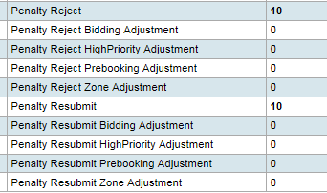
PENALTIES
Notes:
Notes:
Now there are more ways you can adjust penalties for Rejecting/Resubmitting work.
Implemented for fleets that wanted to encourage drivers to do out of town work.
You can see the options in Fleet Configuration -> Properties by typing “penalty” into the search box. Note that most of these are currently hidden from you but will be enabled shortly once the testing is completed.
You can also add adjustments based on attributes as mentioned previously.
Have we implemented a zone based hold time (requested by Launceston)?

Slide 19
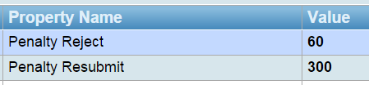

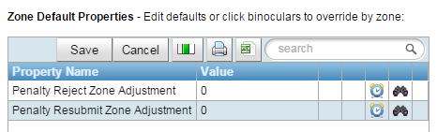
PENALTIES
Initial Values
Job adjustments
Zone Adjustments
Notes:
Notes:
Now there are more ways you can adjust penalties for Rejecting/Resubmitting work.
Implemented for fleets that wanted to encourage drivers to do certain work: prioritizing certain jobs or out of town work.
You can see the options in Fleet Configuration -> Properties by typing “penalty” into the search box. Note that most of these are currently hidden from you but will be enabled shortly once the testing is completed.
You can also add adjustments based on attributes as mentioned previously.
Have we implemented a zone based hold time (requested by Launceston)?

Slide 20
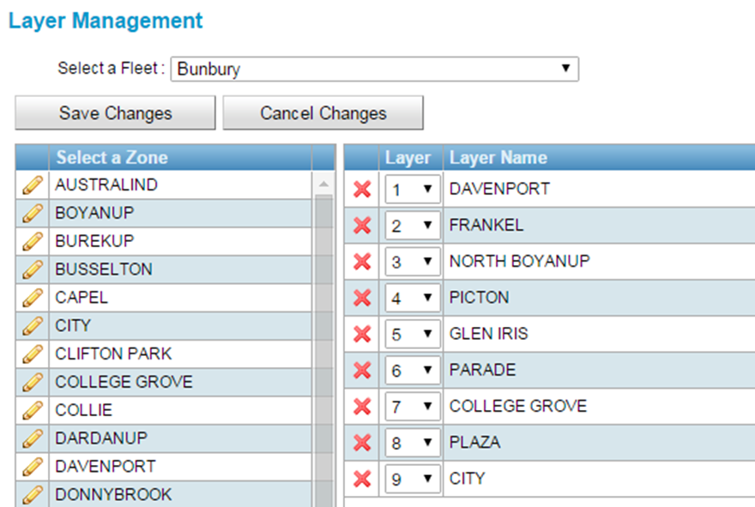
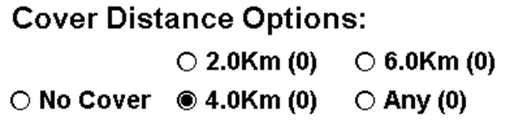
STANDARD ZONES
Layers
Notes:
Notes
For each zone, you can specify where we look for a car.
Note that we look in the zones irrespective of the cover distance set.
If drivers complain they have been sent further than set it is because the dispatching was done using the layers.
Perhaps there are too many zones here. Sue/Ahmad?

Slide 21
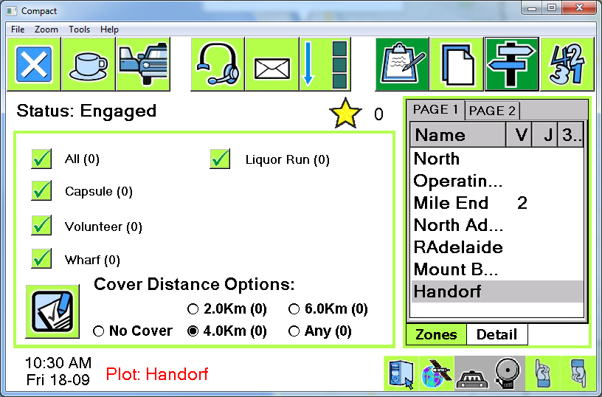
STANDARD ZONES
Plotting
Notes:
Notes
Vacant car not sent if car has plotted.
Choose a zone and press the signpost
Job will be offered to another car if one becomes vacant in the zone first.
Mostly used when going out of town to stop another car being sent out of town.

Slide 22
COVER
Setting distance
Applies when no suitable car in layers.
SmartMove looks for driver prepared to travel to the job.
Choose closest, after adjusting for time vacant.
Notes:
Notes:
When deciding which car gets the job, we adjust the distance based on the time car has been vacant
In this example, vacant for 5 minutes means car is taken to be 1km closer to the job.
Consider suppressing “Any” distance. People can be sent a long way!
– but it’s a balance in every fleet between allowing drivers flexibility and the number of complaints you might get from drivers that don’t know the system very well.

Slide 23
COVER
New queued booking given to the ‘closest’ car willing to do the job
Similarly newly available car given ‘closest’ booking waiting in the cover queue
‘Distance’ adjusted based on time vacant
Example
Car A 3km away
Car B 5km away but vacant 15 minutes
Job given to car B as 3km subtracted from distance to ‘appear’ 2km away
Notes:
Notes:
Cars on the same rank would be maybe 10 metres apart?
That’s equivalent to 5 mins / 100 = 0.05 mins -> 3 seconds.

Slide 24
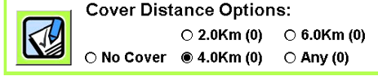
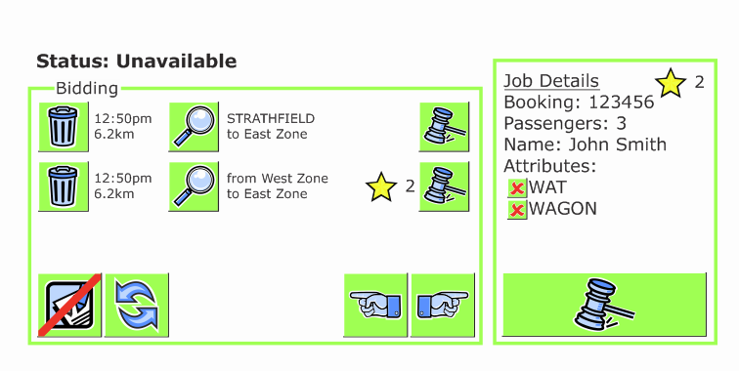
BIDDING
Notes:
Notes:
As an option, drivers can see the work that is waiting on the cover list.
Driver can see some job details then bid. No guarantee the job will be allocated as it might have been offered to someone else.
Can remove entry from list.
Can refresh the list.
Generally we don’t like this way of working, but it is provided for fleets that want it.

Slide 25
CLOSEST CAR
No location dispatch
Intended to be used when a job must be dispatched (or has waited too long)
Will be allocated to “closest” suitable car
Normally set for wheelchair work
Vehicle settings can be ignored

